Slide 1

Exam AZ-303: Microsoft Azure Architect Technologies Crash Course
Tim Warner

Slide 2


Tim Warner
Based in Nashville, TN, US
MCT, MVP
Twitter: @TechTrainerTim
Badge: timw.info

Slide 3
Day 1 of 2 Agenda
Introduction
Blah
Exam AZ-303 strategy

Slide 4
Day 2 of 2 Agenda
Content catch-up
Blah
Exam AZ-303 Strategy

Slide 5
Course Materials
timw.info/az104

Slide 6
A Different Kind of Training
Let's avoid slide show fatigue
We'll learn by doing – at least 80 percent demo
Case study approach
This is an expert certification, so we will move quickly and assume intermediate-level Azure skills
5-minute break at midpoint
I’m here to answer your questions – take advantage of this!
Use the Q&A panel

Slide 7
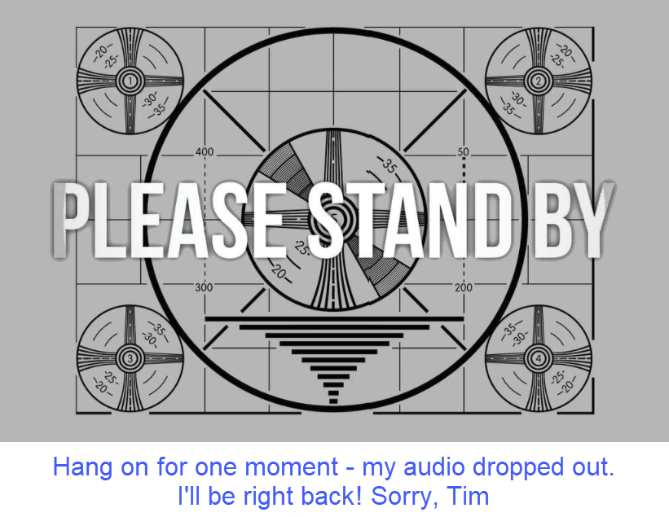
If my audio drops out, you'll see…

Slide 8

Session Recordings

Slide 9
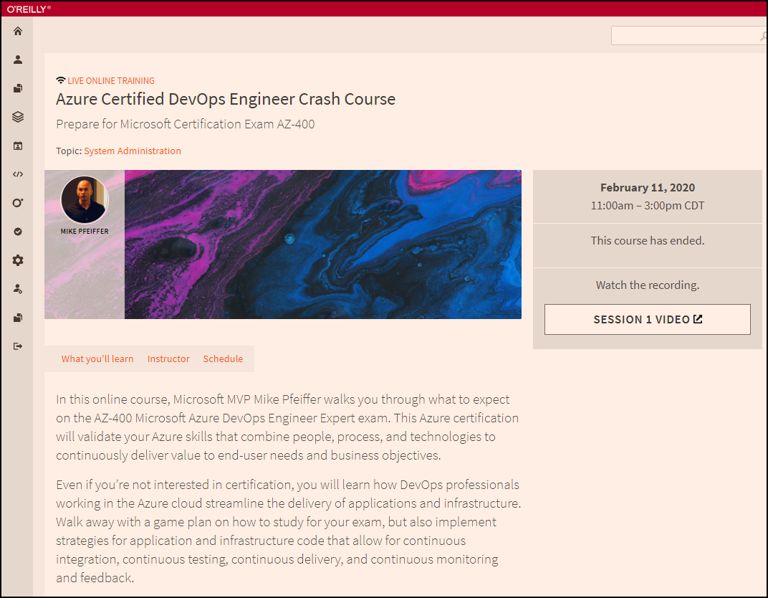
Session Recordings

Slide 10

Session Recordings

Slide 11
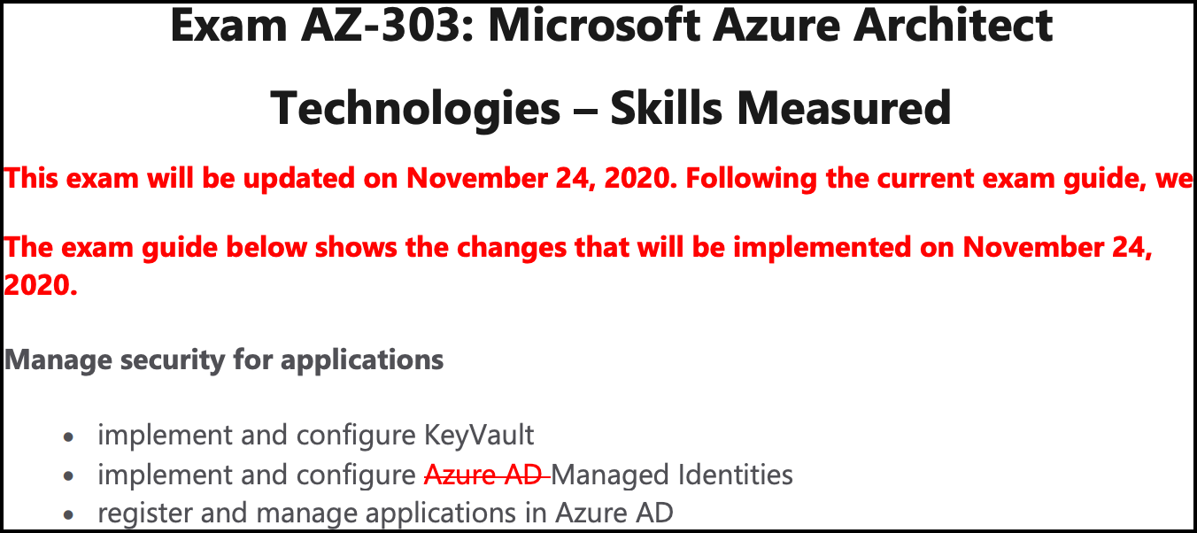
Azure Architect 2020 Changes

Slide 12
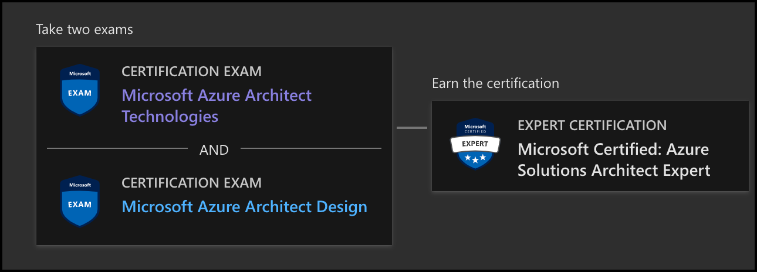
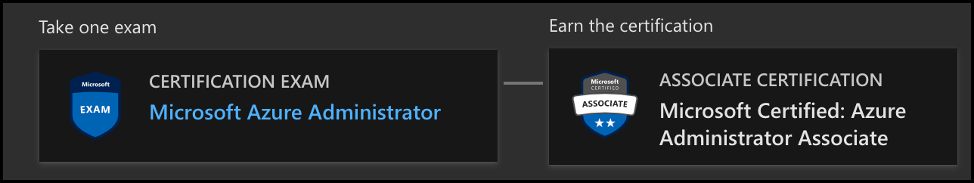
Azure Architect Facts and Tips

Slide 13
Tim's Certification Study Pyramid
Interdependence
Content knowledge
Practical application
Test-taking skills

Slide 14
Thank you!
Course materials: timw.info/az303
Twitter: @TechTrainerTim
Work: timw.info/ps
Web: TechTrainerTim.com

Slide 15
Authentication

Slide 16

Hybrid Identity

Slide 17

Passthrough Authentication

Slide 18

Seamless Single Sign-on

Slide 19
Azure Storage

Slide 20
Storage Account Replication
1
3
3
2
LRS
ZRS

Slide 21
Storage Account Replication
1
3
1
3
2
2
GRS – RA/GRS

Slide 22
Azure Compute

Slide 23
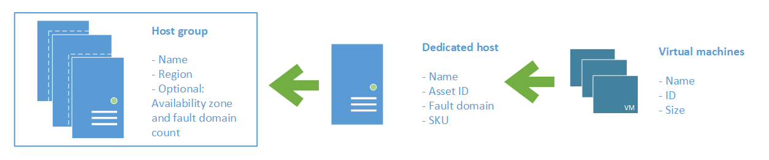
Azure VM Dedicated Host

Slide 24
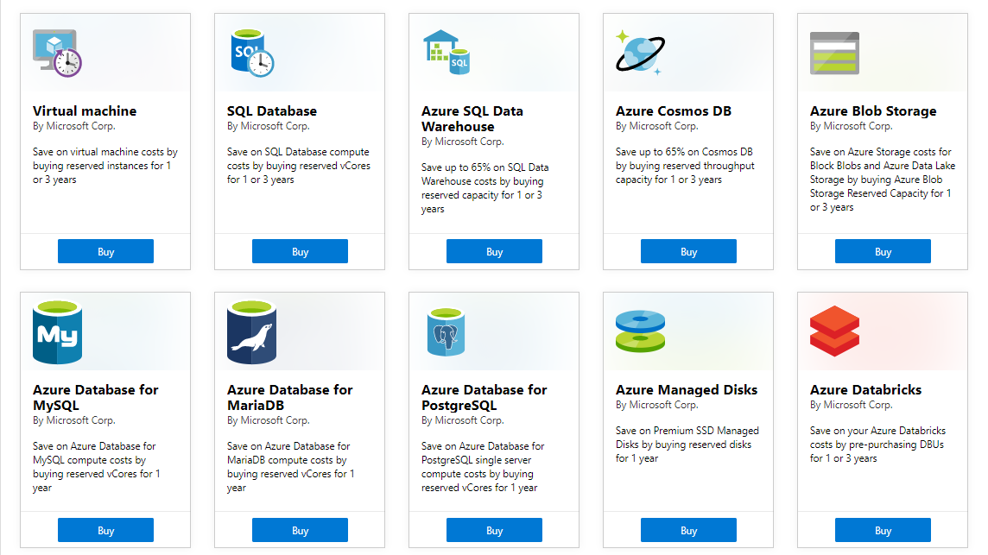
Azure Reservations

Slide 25

VM Scale Sets

Slide 26
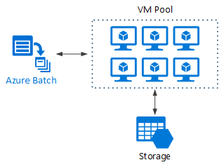
Azure Batch

Slide 27

Availability Set

Slide 28

Availability Zone

Slide 29
Migration and Disaster Recovery

Slide 30
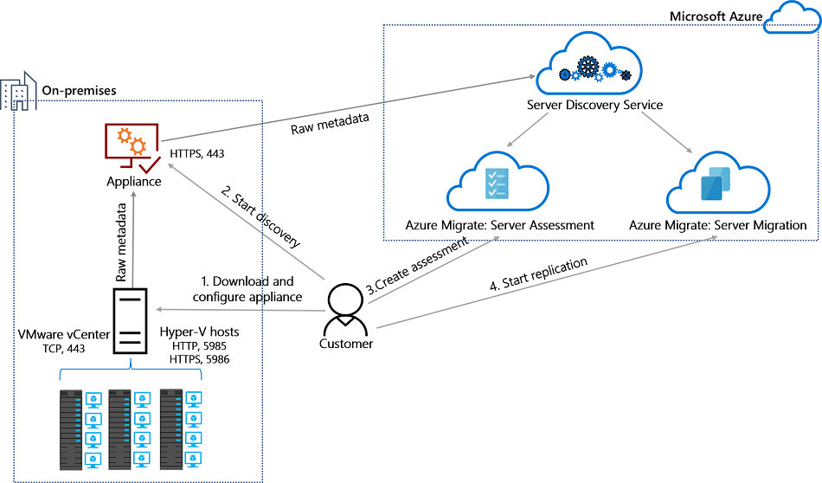
Azure Migrate

Slide 31

Azure Backup

Slide 32

Azure Site Recovery

Slide 33
Load Balancing

Slide 34

VM Networking

Slide 35

Load Balancing

Slide 36

VNet Peering

Slide 37

Hybrid Networking

Slide 38

Network Virtual Appliance

Slide 39

Azure Load Balancer

Slide 40

Application Gateway

Slide 41

Traffic Manager

Slide 42

Front Door Service

Slide 43
Governance

Slide 44

Tenant vs. Subscription

Slide 45

Azure Management Scopes
/ Tenant Root

Slide 46
App Architecture

Slide 47


Docker Container Lifecycle
https://timw.info/3635f

Slide 48

Event Architecture

Slide 49
Data Platform

Slide 50

Always Encrypted

Slide 51
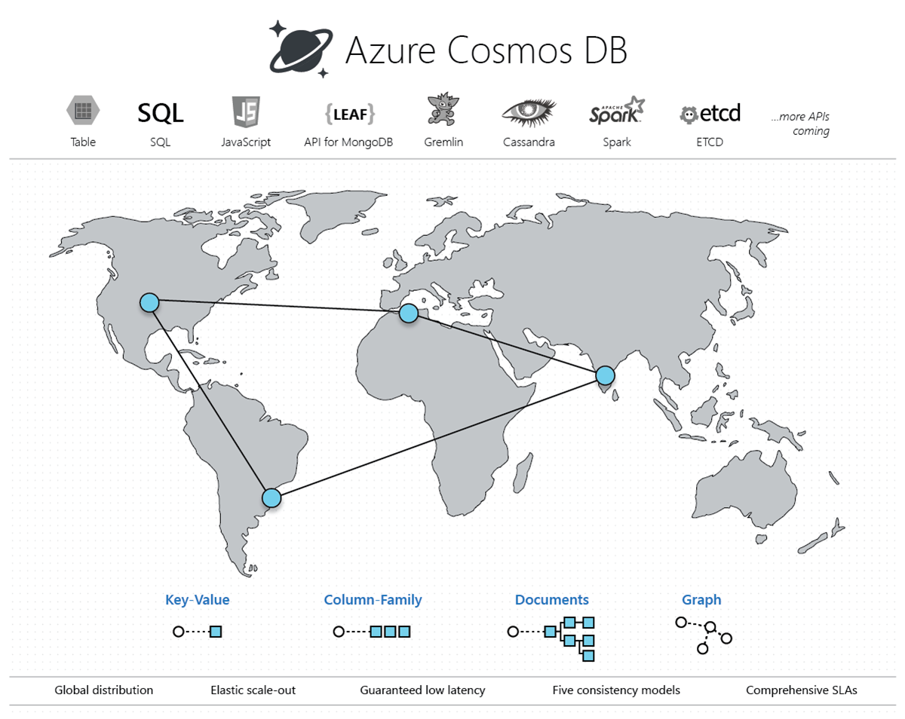
Cosmos DB

Slide 52
Exam AZ-303 Item Types

Slide 53

Multiple Choice

Slide 54
Repeated Scenario
You need to move an Azure VM to another hardware host.
Solution: You redeploy the VM.
Does this solution meet the goal?
Yes
No

Slide 55

Select and Place

Slide 56

Build List and Reorder

Slide 57

Active Screen/Fill in the Blank

Slide 58

Case Study

Slide 59






Performance-Based Lab

Slide 60
Microsoft Online Testing

Slide 61
Microsoft Online Testing Process
timw.info/online

Slide 62

Microsoft Online Testing Process

Slide 63

Microsoft Online Testing Process

Slide 64

Microsoft Online Testing Process

Slide 65

Microsoft Online Testing Process

Slide 66

Microsoft Online Testing Process

Slide 67

Microsoft Online Testing Process

Slide 68

Microsoft Online Testing Process

Slide 69
AZ-303 Exam Strategy
Focus your skills accordingly:
60 percent Azure portal
20 percent Azure PowerShell
10 percent Azure CLI
10 percent KQL
Expect performance-based labs, but be thankful if you don't see 'em

